Slide 1

Team Leader : VESAVI DURGA PRASAD
Team Members : PARDESI PAVAN SAI

Slide 2
COMPREHENSIVE DIGITAL MARKETING FOR TATA MOTORS

Slide 3

INTRODUCTION
BRANDING “ TATA MOTIORS”
ANALYSING OF BRAND MESSAGING
SMART GOALS OF TATA MOTORS
KPI‘s OF TATA MOTORS
COMPITATOR ANALYSIS
BUYERS / AUDIENCE PERSONA
SEO and KEYWORD RESEARCH
CONTENT IDEAS and MARKETING STRATEGIES
CONTENT CREATION and CURATION
INSTAGRAM STORY

Slide 4
TATA MOTORS
INTRODUCTION :
Tata Motors has a remarkable portfolio of both passenger and commercial vehicles and have been leading India’s commercial vehicles space for several years. The Company operates six principal automotive manufacturing facilities in India: at Jamshedpur in the state of Jharkhand, at Pune in the state of Maharashtra

Slide 5
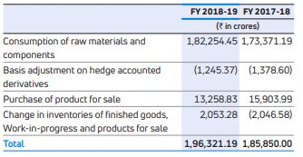

TATA MOTOTRS.

Slide 6
Brand study, Competitors Analysis and Buyer’s/Audiences Persona.
Research of Brand Identity
Mission/ Values :- To deliver value through our products and services and to be the most trusted global network for our customers and suppliers. To be a responsible value-creation partner for all stakeholders. To innovate mobility solutions with a passion to enhance the quality of life
USP :-The USP of Tata Motors is their focus on message execution and image building to associate the brand with positive imagery that impacts consumer perception and long-term reactions.

Slide 7
Analyzing of Brand messaging
Tagline : Along with the new brand name, Tata has also unveiled its new brand tagline - 'Move with Meaning', which reflects the sustainability at the core of Tata.
Logo : The Tata logo symbolizes fluidity and adaptability. It is also said to depict a fountain of knowledge, or a tree of trust under which people can take shelter. The blue color in the Tata logo stands for excellence, reliability and strength of the company's products.
Innovation : Tata Motors has already developed next-gen clean, green fuel based commercial vehicles, such as the Magic Iris Electric, a zero-emission commercial passenger vehicle which uses solar energy for supplementary charging, and the hybrid Starbus, a clean fuel solution for public transport.
Values : Integrity, Responsibility, Excellence, Pioneering, and Unity.
Digital transformation : Tata Motors' sophisticated connected digital ecosystem has helped it tend to breakdowns at a much faster rate, reducing vehicle off-road times for commercial vehicles by 75%.

Slide 8
Smart Goals of TATA MOTORS
To be the most reliable global network for customers and suppliers, that delivers value through products and services. To be a responsible value creator for all our stakeholders.
With an unwavering vision, we dedicate ourselves to achieving holistic decarbonisation across our business, encompassing Scope 1, Scope 2, and Scope 3 emissions. Our aim is to achieve Net Zero greenhouse gas emissions for our passenger and commercial vehicles businesses by 2040 and 2045 respectively.

Slide 9
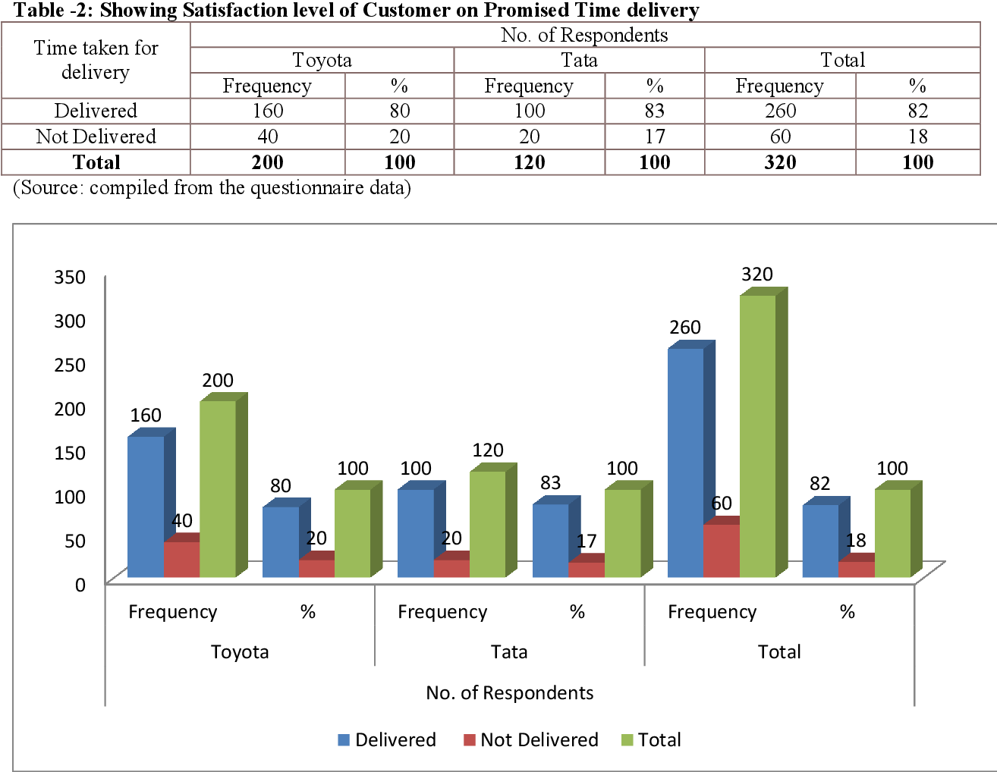
KPIs of TATA MOTORS
Revenue growth : TML delivered a strong performance in Q3 FY24 with Revenue of ₹110.6K Cr (up 25.0%), EBITDA at ₹15.8K Cr (up 60.6%) and EBIT of ₹9.2K Cr (+₹5.3K Cr) with all automotive verticals continuing their profitable growth trajectory
Client Satisfaction :

Slide 10
Environmental & Social responsibility : We strive to minimise our impact on the environment through a range of green initiatives like promotion of renewable resources, creation of carbon sinks through large-scale sapling plantation, construction of water conservation structures and building awareness among the communities.

Slide 11
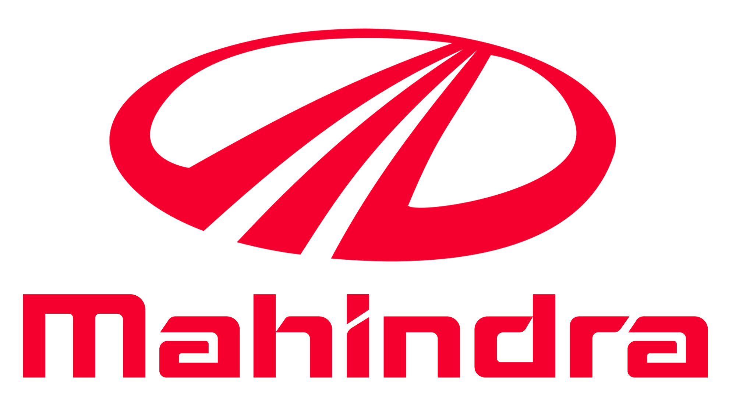
Competitors Analysis
Compitators to TATA MOTORS
COMPETITOR 1: MAHINDRA
USP : cars were synonymous with affordability. Another USP of these cars was the high resale value. The cars easily offered a 40-50 percent return value even after 3-4 years from the date of purchase.
Strength : Mahindra operates in a wide range of sectors, from automotive to IT services, real estate, finance, and agriculture, among others. This diversified portfolio helps the company spread risks and leverage opportunities in various industries.

Slide 12
Weaknesses : limit your company's ability to reach its full potential. Geographic Dependence: Mahindra & Mahindra is dependent on the majority of its revenue (over 60%) from India, which would affect its business in case of any economic slowdown or high inflation.
Brand Mahindra faced key challenges including brand inconsistency across businesses, a decentralized structure, and an old-fashioned perception. An analysis found inconsistent brand identity use, no distinction between corporate and subsidiary brands, and a lack of appeal to youth.

Slide 13
COMPETITOR 2 : FORD
USP : Ford has an international brand presence due to one of the oldest car manufacturing company and also provides a wide range of cars
Swat Analysis :
Strength :. The company's brand strength is underpinned by its iconic Ford trucks, sport utility vehicles, and the luxury Lincoln vehicles, which continue to resonate with consumers. Ford's commitment to innovation is evident in its Ford+ plan, aimed at enriching customer experiences and fostering loyalty.
Weaknesses : Lincoln in particular is widely considered an inferior product to British and Germany luxury cars, even in the United States. Heavy dependence on U.S. and European auto markets. Most experts believe future growth in car sales will be in emerging markets such as China and India.
Opportunities : Eco-Friendly Vehicles
Increase Customer Base
Digital Marketing.
Self-driving car.

Slide 14
Buyer’s / Audience Persona
Target audience might be young people who are just starting out and looking for an affordable car to get around in. On the other hand, if Tata Motors is selling a luxury SUV, its target audience might be wealthy individuals or families who want a comfortable and spacious vehicle for long drives.
Behind the success of Tata's commercial vehicles business lies Tata's deep connect with the masses. The company targets customers largely from the rural and semi-urban.

Slide 15
SEO and KEYWORD RESEARCH
Website Traffic : In March tatamotors.com received 18.15M visits with the average session duration 09:50. Compared to February traffic to tatamotors.com has increased by 66.5%.
Back Link analysis : Tata Motors has an employee rating of 4.2 out of 5 stars, based on 3,288 company reviews on Glassdoor which indicates that most employees have an excellent working experience there. The Tata Motors employee rating is 24% above average for employers within the Manufacturing industry (3.4 stars).
Duplicates : There is duplicates for TATA MOTORS IS HITACHI
No malware found in the website
0 pages were blocked by robots.text
No pages have content with low word count
No pages without headers are ddetected.
Found 5 page redirects
KEYWORD RESEARCH :
Keyword for TATA MOTORS – there are many keyworda forTATA MOTORS .

Slide 16
On page optimization :
Search Engine Optimization (SEO): Tata Motors makes sure that its website appears at the top of search engine results when people search for keywords related to their products. This is done through various SEO techniques like optimizing website content and building backlinks.
TML's focus is on strengthening market presence by offering solutions that meet and surpass customers’ expectations and deliver hassle-free sales and service experience to customers. JLR's philosophy of 'Customer First' enables personalised and 'easy to do with' experience for its customers.
Maintain a Fast, Mobile-friendly Website.
Target Long-tail Keywords.
Optimize Local Listings.
Create Helpful Content (and Optimize It for SEO)
Re-optimize Past Content.

Slide 17
Content ideas and Marketing strategies
Digital Marketing Strategies of Tata MotorsSocial Media Marketing: Tata Motors uses social media platforms like Facebook, Instagram, and Twitter to promote its products and engage with customers. They share images and videos of their vehicles and also run social media campaigns to attract new customers.
1.Tata Motors:- Social media marketing strategies
The company uses social media to promote its brand values and share glimpses of how they contribute to the local community. They also discuss important issues and discuss the issue including gender equality, malnutrition, sanitation, and clean water, as well as other topics .They also use social media marketing strategy for e-commerce website.
Tata Motors: Website Design
Tata Group’s website Tata Group has a user-friendly website filled with intriguing content that draws a significant readership regularly. The website is an entire one-stop shop for all details about the business, including its history, segment-by-segment operation, new product launches, critical business news, and current job openings. The website’s improved responsiveness helps it to stay in the top position of results for search engines, which is a sign of efficient search engine Optimization (SEO).

Slide 18
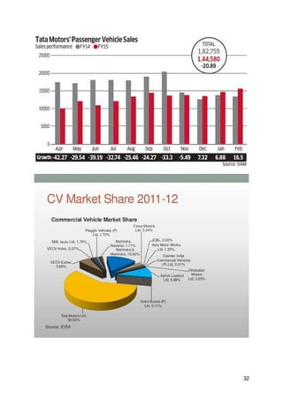
Ex :- Graph with the strategy, aim and idea of each content piece
TATA MOTORS MARKET SHARE

Slide 19
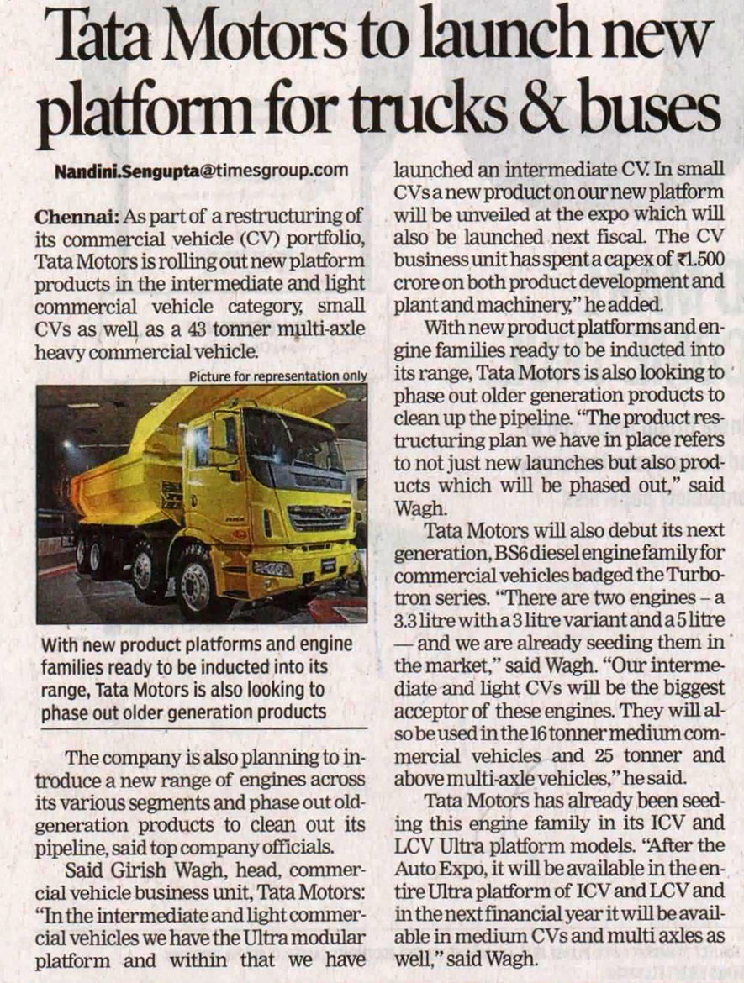
Content creation and Curation
Post creation :
Formate 1 : Article
TATA MOTORS Tata Motors Finance Limited (TMFL) was incorporated on June 1, 2006, with the objective of becoming a preferred financing provider for the customers of TML's dealers. TMFL is registered with the RBI as a Non-Deposit Taking Non-Banking Financial Company (NBFC) and is classified as an Asset Finance Company under the RBI’s regulation on NBFCs. TATA MOTORS FINANCE LIMITED Among the top 3 in Global CV and Domestic PV We innovate mobility solutions with passion to enhance quality of life Achieving Sustainable Financial Performance Delivering Exciting Innovations As a High-Performance Organisation, we are, by FY 2019 Vision Mission TATA AND OTHER BRANDS Tata Motors has a remarkable portfolio of both passenger and commercial vehicles and have been leading India’s commercial vehicles space for several years. The Company operates six principal automotive manufacturing facilities in India: at Jamshedpur in the state of Jharkhand, at Pune in the state of Maharashtra, at Lucknow in the state of Uttar Pradesh, at Pantnagar in the state of Uttarakhand, at Sanand in the state of Gujarat and at Dharwad in the state of Karnataka. Tata Motor’s Operating Philosophy is reflected in its Vision, Mission and Values.

Slide 20
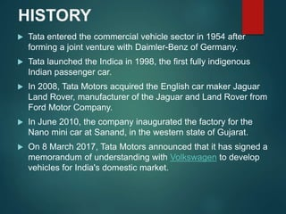
Format 2 : STORY
Incorporated in India in the year 1945, Tata Motors is a part of the over $100 billion Tata Group founded by Jamsetji Tata in 1868. Recognised for its world-class quality, originality, engineering and design excellence, the Company is on the path of shaping the future of mobility in India.
Caption along with CTA’s
In every unpredictable situation, we are always with you.
Contact us :
Commercial vehicles. cac@tatamotors.com. 1800 209 7979.
Passenger vehicles. customercare@tatamotors.com. 1800 209 8282.
Electric vehicles. customercare@tatamotors.com. 1800 209 8282.

Slide 21
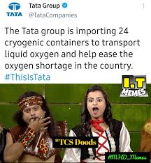
Format 3 : MEME
THE TATA GROUP IS IMPORTING 24 CRYOGENIC CONTAINERS TO TRANSPORT LIQUID OXYGEN AND HELP EASE THE OXYGEN SHORTAGE IN THE COUNTRY.

Slide 22
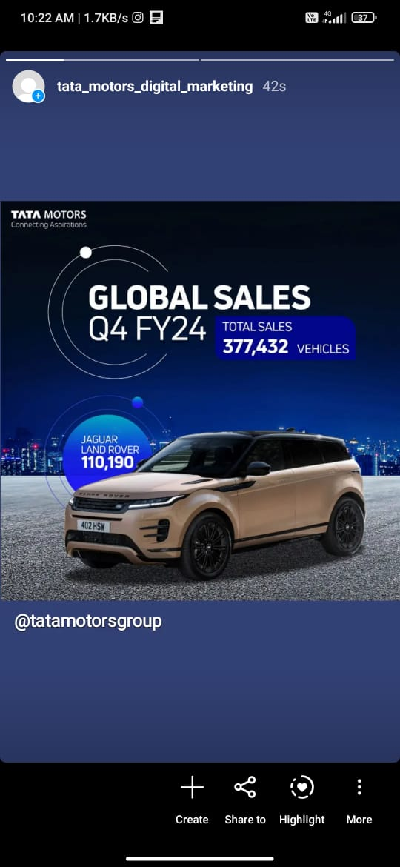
INSTAGRAM STORY
Instagram story link – 1
https://www.instagram.com/stories/tata_motors_digital_marketing/3348697797106203915?igsh=cmZuY2lydXUwcWg3
Instagram story Highlights -1
https://www.instagram.com/s/aGlnaGxpZ2h0OjE3ODk0MDc1Nzc3OTkxMzgx?story_media_id=3348697797106203915_55929478142&igsh=MTQweDZxem5nejZ1cw==

Slide 23
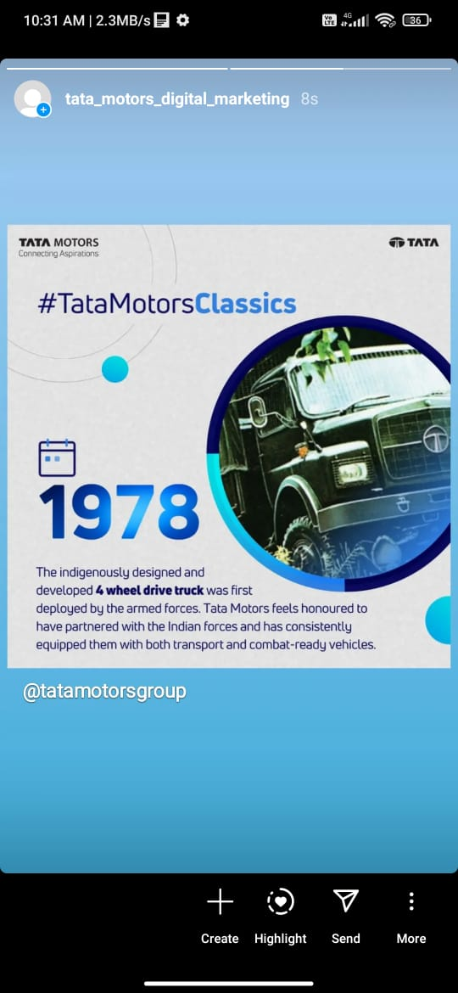
Instagram Story Link - 2
https://www.instagram.com/stories/tata_motors_digital_marketing/3348702598057611396?igsh=Z2hpZ2szMHV3dGNp
Instagram Highlight Link- 2
https://www.instagram.com/s/aGlnaGxpZ2h0OjE3ODc1MzEzNzU0MDE3NDE4?story_media_id=3348702598057611396_55929478142&igsh=MXdvMXk4MndzaGE1NQ==

